Slide 1

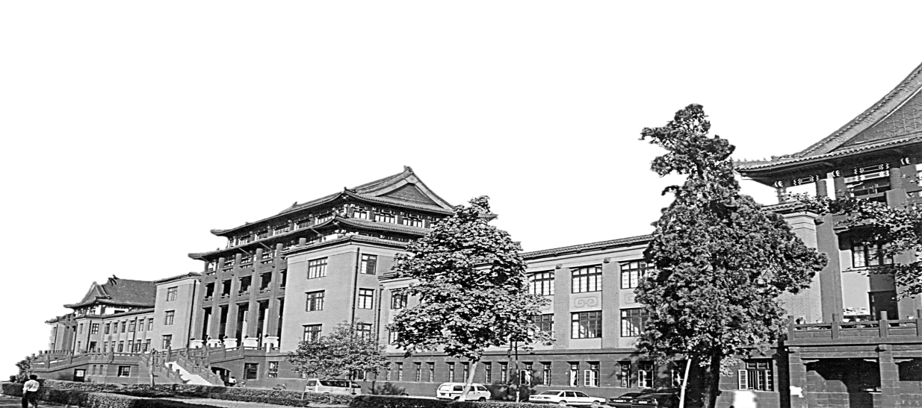
Transformer in medical image
陈祥
2021.06.16

Slide 2
TransCT: Dual-path Transformer for Low Dose Computed Tomography
Zhicheng Zhang 1 , Lequan Yu 1 , Xiaokun Liang 1 , Wei Zhao 1 , Lei Xing 1
1Department of Radiation Oncology, Stanford University, Stanford,

Slide 3
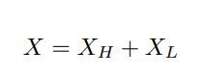
Method
对于图像去噪，噪声主要包含在高频子带中。此外，剩余的低频子带不仅包含主图像内容，还包含无噪声的弱化图像纹理。这些减弱的图像纹理可用于帮助去除高频子带中的噪声
首先，将 LDCT 图像分解为高频 (HF) 部分和低频 (LF) 部分
使用标准差为 1.5 的高斯滤波器将 LDCT 图像分解为高频和低频部分
为了在保留图像内容的前提下去除图像噪声，我们从LF部分提取相应的内容特征和潜在纹理特征。同时，我们从 HF 部分提取相应的嵌入。结合两者重建最终的高质量 LDCT 图像。
在低频部分的潜在纹理的帮助下去除高频部分的噪声

Slide 4
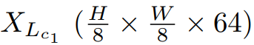
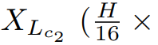
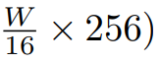
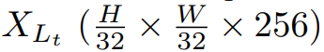
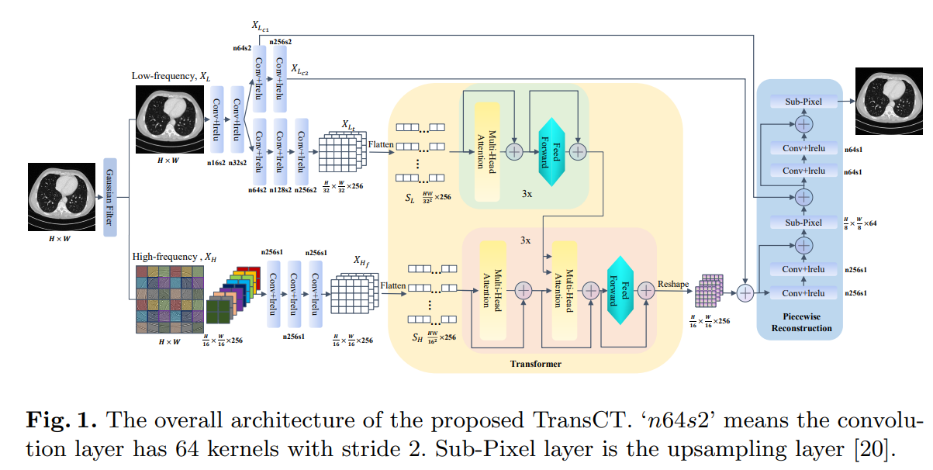
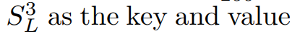
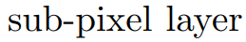
Method
首先使用两个 CNN 从 低频部分 中提取相应的内容特征 XLc 和纹理特征 XLt。
three encoders and three decoders

Slide 5
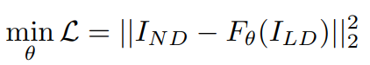
Experiment
Loss:
F is the proposed model and θ denotes the network parameters.
Trained 300 epochs with a mini-batch size of 8
Setting: 32 GB RAM, and a GeForce GTX TITAN X GPU with 12 GB RAM. Initialized with xavier initialization.
Dataset: AAPM-Mayo Clinic Low-Dose CT Grand Challenge
quarter-dose CT images
10 training patient cases into 7/1/2 cases, related to the training/validation/testing datasets

Slide 6
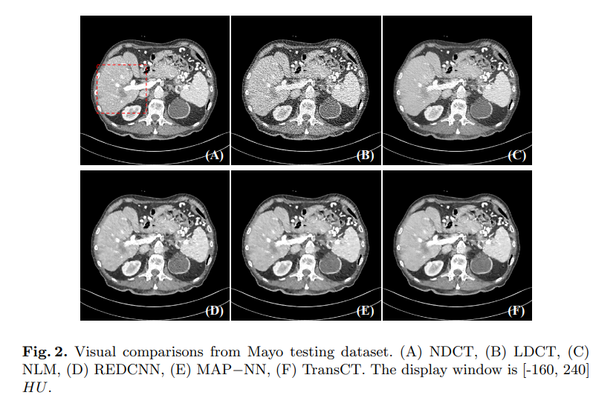
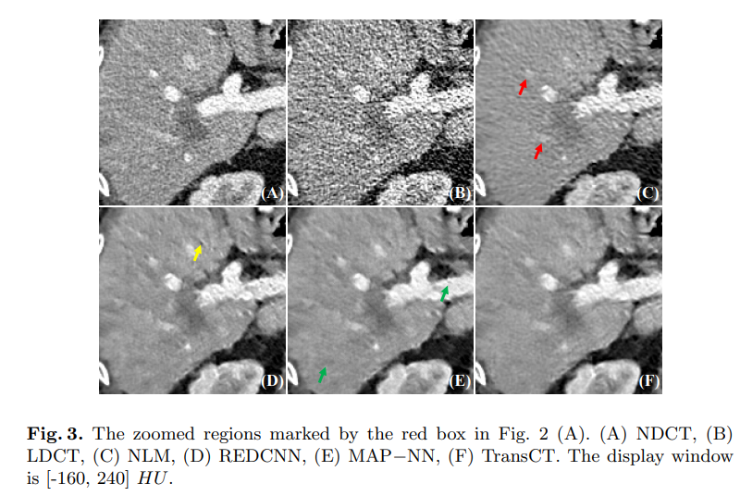
Experiment
MAP-NN Nature Machine Intelligence (2019)

Slide 7
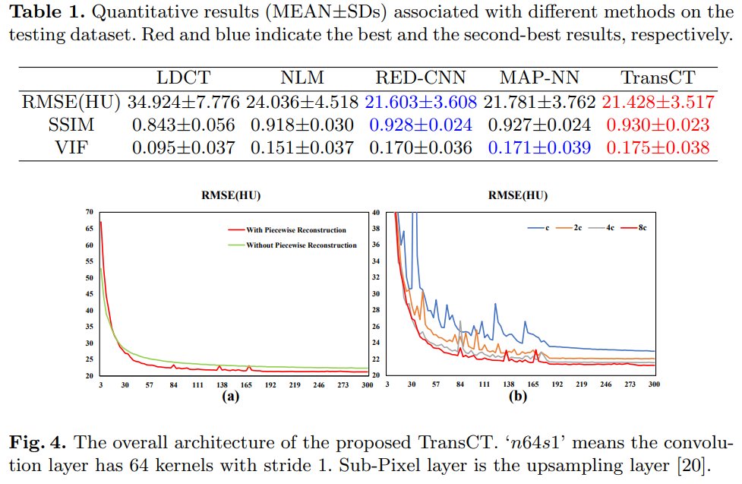
Experiment
Visual Information Fidelity (VIF)
After the output of the third transformer decoder, we used a sub-pixel layer to directly reconstruct the noise-free high-resolution HF texture, and then we added this HF texture and XL to obtain the final LDCT image.
dimension of the hidden layer in the feed-forward network

Slide 8
TED-net: Convolution-free T2T Vision Transformer based Encoder-decoder Dilation network for Low-dose CT Denoising
Dayang Wang1 , Zhan Wu1 , Hengyong Yu1,*
Department of Electrical and Computer Engineering, University of Massachusetts Lowell, Lowell, MA, USA

Slide 9
Overall Algorithm Overview
Convolution-based methods has limited ability to capture contextual information with long spatial dependence in image or feature maps.
Proposed a no convolution-free model for LDCT denoising

Slide 10
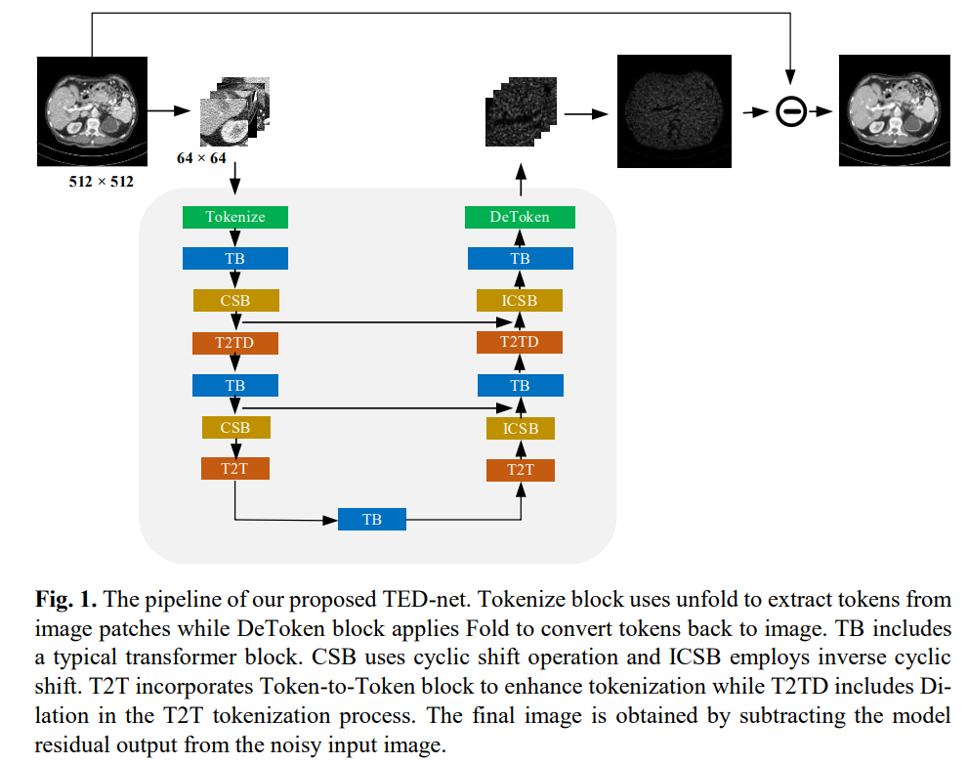
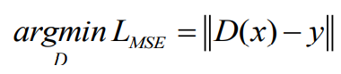
Overall Algorithm Overview
Three soft split stages

Slide 11
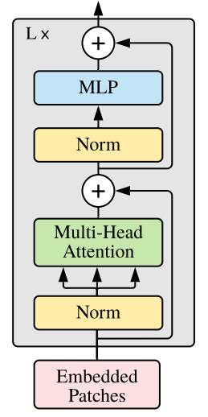
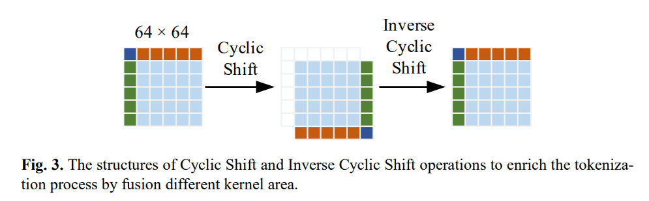
Overall Algorithm Overview
Transformer Block(TB)
Cyclic Shift Block(CSB) and Inverse Cyclic Shift Block(ICSB)

Slide 12
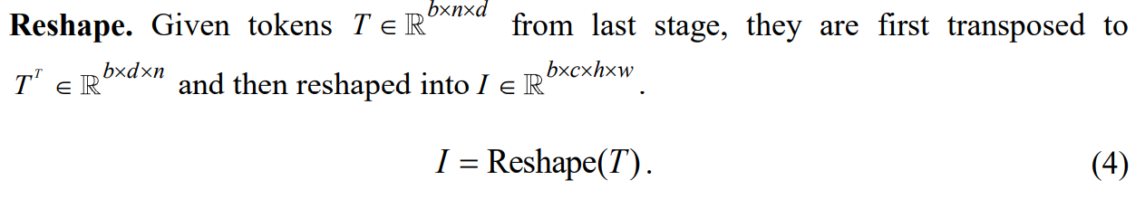
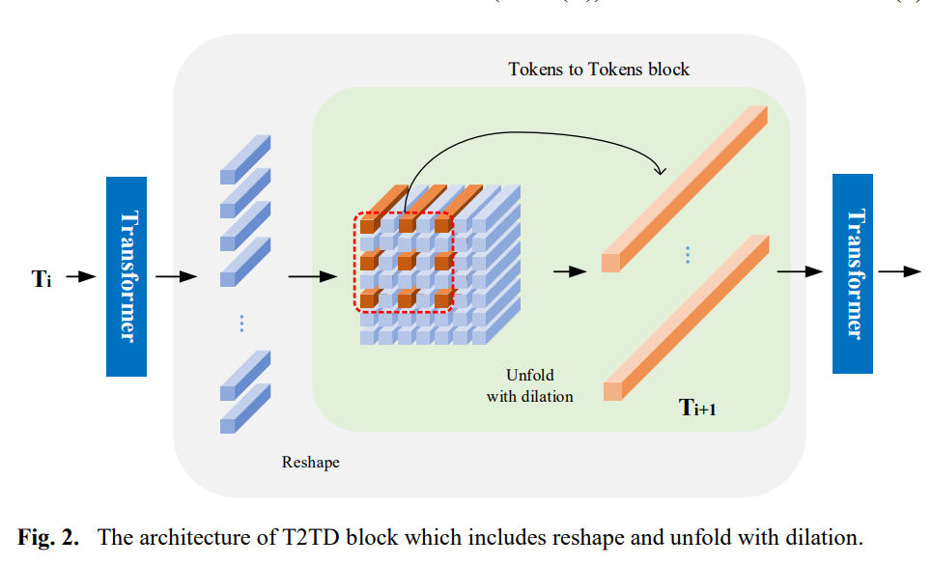
Token-to-token(T2T) and Token-to-token Dilation Block(T2TD)
Traditional tokenization: reshape or convolution
use dilation in the tokenization process to refine the contextual information fusion and seek relation across larger regions.
Token-to-token Dilation(T2TD):
Token-to-token(T2T):
Reshape, Then the number of tokens are reduced by combining several neighboring tokens into one unit.

Slide 13
Experiment
Dataset:2016 NIH-AAPM-Mayo Clinic LDCT Grand Challenge quarter-dose LDCT
Data augmentation is also applied to enlarge the dataset where we keep a copy of original image and then randomly apply image rotation (90 degrees, 180 degrees or 270 degrees) and flipping (up and down, left and right) to the original one.
Trained with 2 NVIDIA 2080TI 11G GPUs.
The kernel size for the three unfold/fold operations are 7×7, 3×3, 3×3 with a stride of (2,1,1) and a dilation of (1,2,1)
Moreover, the token dimension in the encoder/decoder part is 256, and pixel quantity is 2 for the two cyclic shift layers.

Slide 14
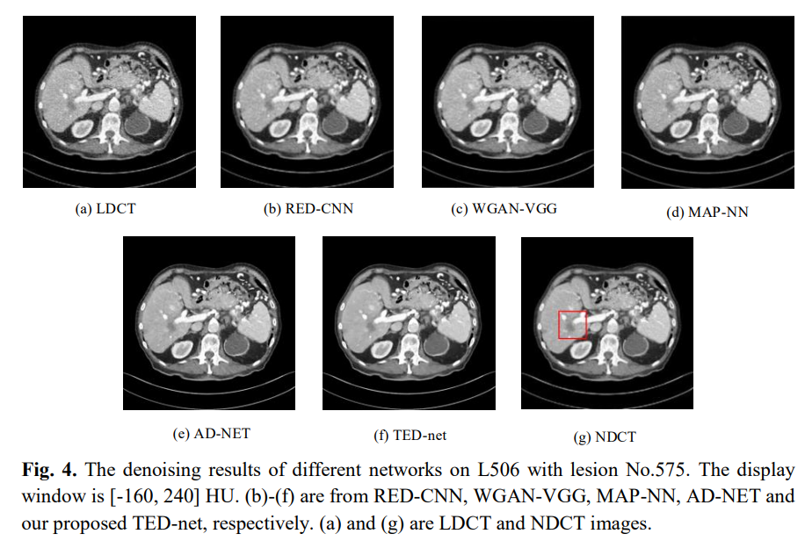
Experiment
WGAN-VGG:
TMI 2018
AD-Net:
Neural Networks 2020

Slide 15
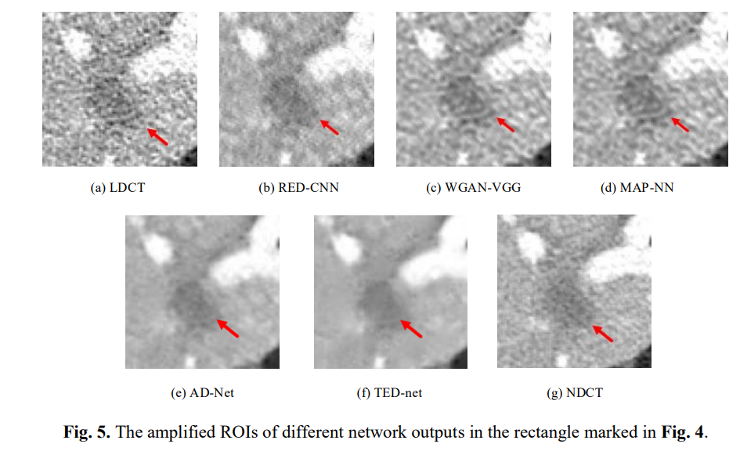
Experiment

Slide 16
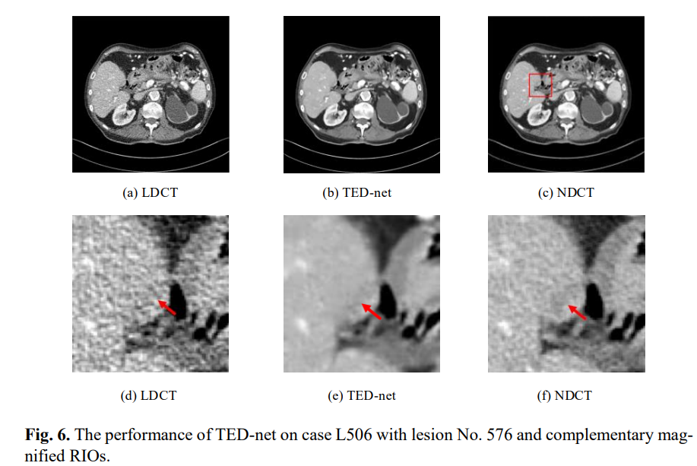
Experiment

Slide 17
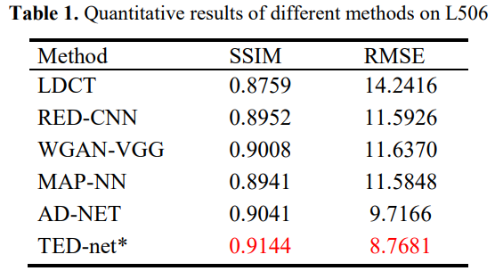
Experiment

Slide 18
Swin-Unet: Unet-like Pure Transformer for Medical Image Segmentation
Hu Cao 1 † , Yueyue Wang 2 † , Joy Chen 1 , Dongsheng Jiang 3 ∗ , Xiaopeng Zhang 3 ∗ , Qi Tian 3 ∗ , and Manning Wang 2
1 Technische Universit at Munchen, Munchen, Germany
2 Fudan University, Shanghai, China
3 Huawei Technologies, Shanghai, China

Slide 19
Contribution
Based on Swin Transformer block, we build a symmetric Encoder-Decoder architecture with skip connections. In the encoder, self-attention from local to global is realized; in the decoder, the global features are up-sampled to the input resolution for corresponding pixel-level segmentation prediction.
A patch expanding layer is developed to achieve up-sampling and feature dimension increase without using convolution or interpolation operation.
It is found in the experiment that skip connection is also effective for Transformer

Slide 20
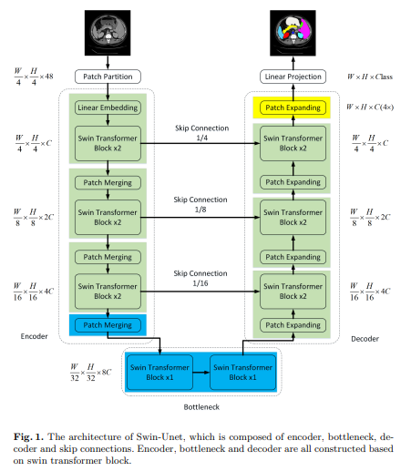
Algorithm Overview
Images are split into non-overlapping patches with patch size of 4 × 4
Patch merge:
divided into 4 parts and concatenated together by the patch merging layer. Then a linear layer is applied
arbitrary dimension (represented as C)
Patch Expanding:
First linear layer is applied. Then use rearrange operation
Skip connection:
concatenate the shallow features and the deep features. Then a linear layer

Slide 21
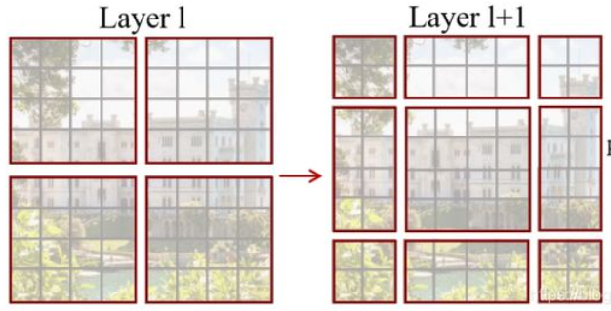
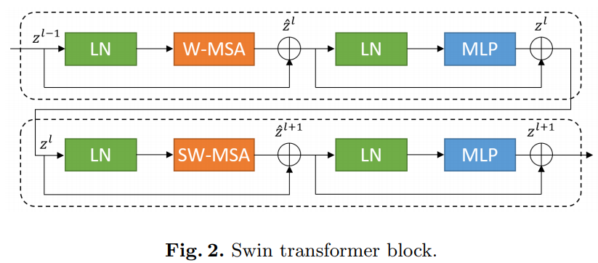
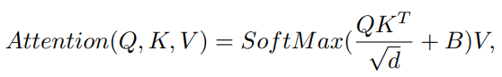
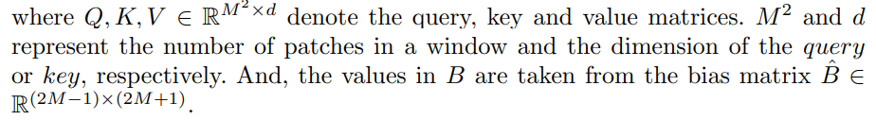
Overall Algorithm Overview

Slide 22
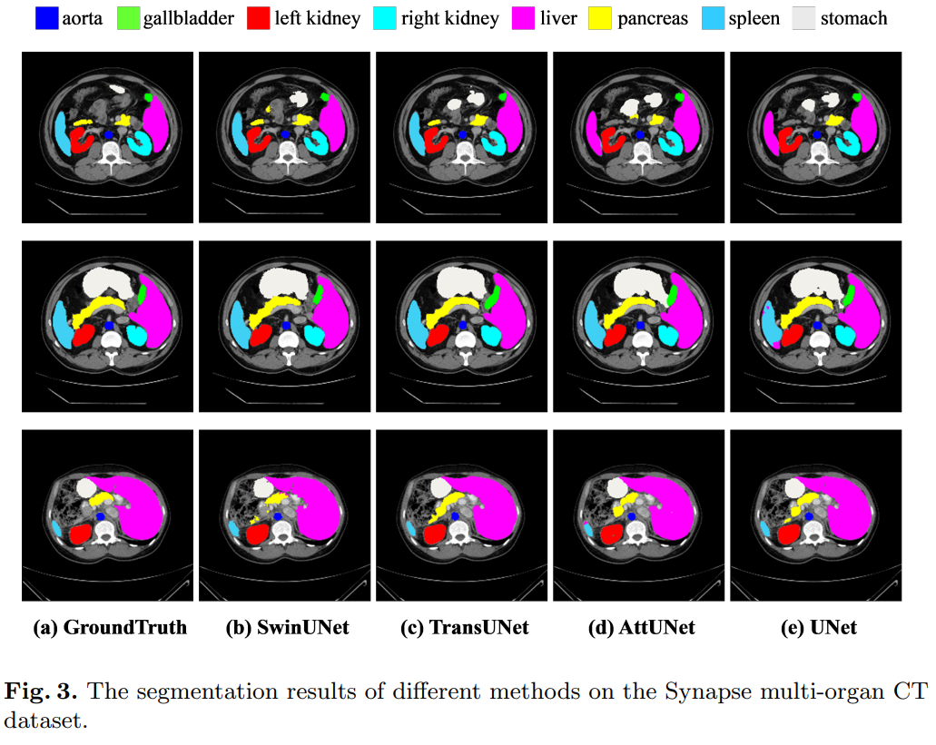
Experiment
The input image size and patch size are set as 224×224 and 4, respectively. We train our model on a Nvidia V100 GPU with 32GB memory. The weights pre-trained on ImageNet are used to initialize the model parameters.
Data augmentations such as flips and rotations are used to increase data diversity
Synapse multi-organ segmentation dataset (Synapse): the dataset includes 30 cases with 3779 axial abdominal clinical CT image

Slide 23
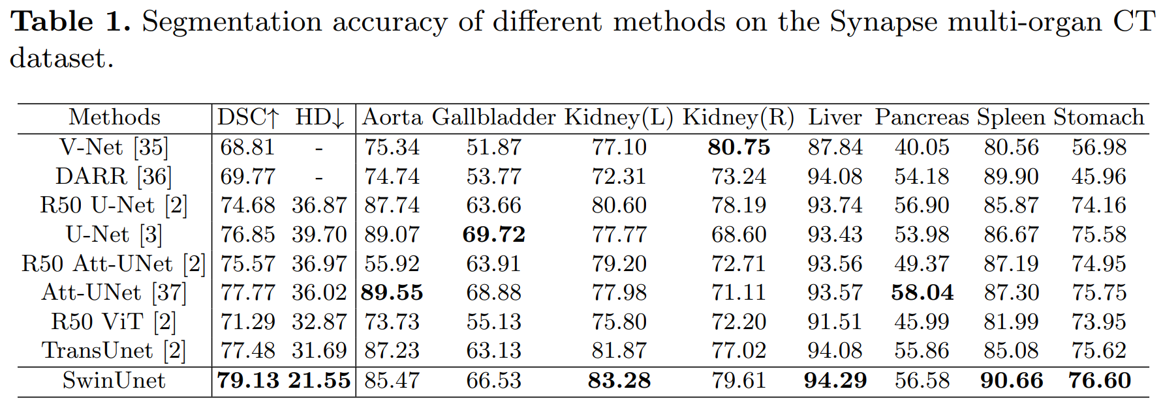
Experiment

Slide 24
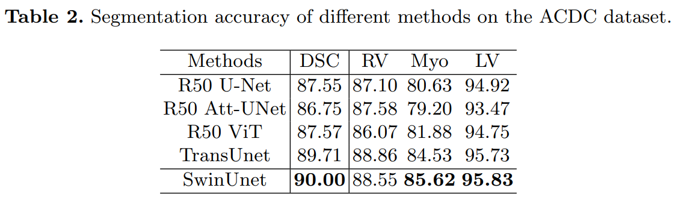
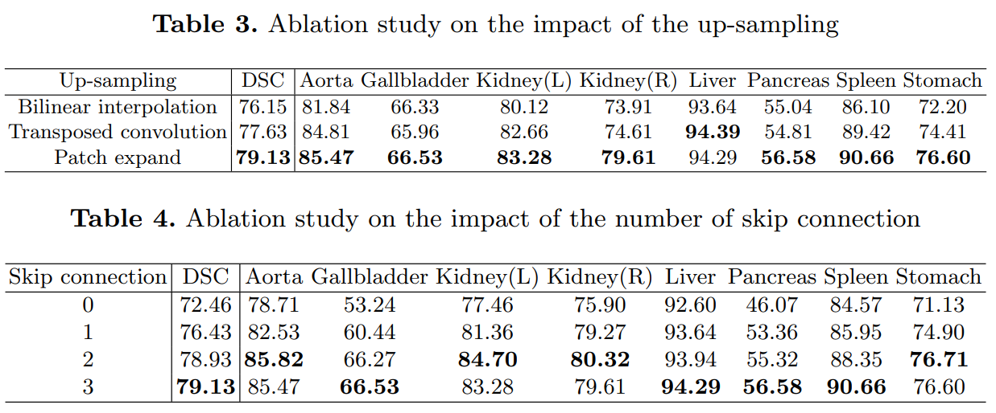
Experiment

Slide 25
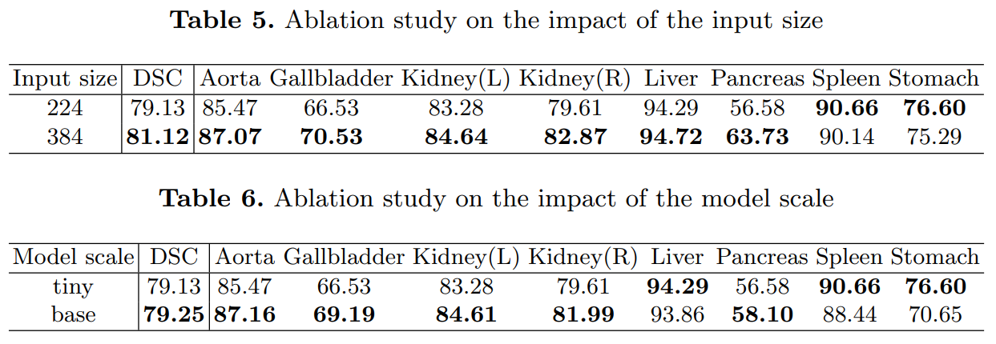
Experiment
Considering the accuracy-speed trade off, we adopt the Tiny-based model to perform medical image segmentation.

Slide 26
Uformer: A General U-Shaped Transformer for Image Restoration
Zhendong Wang1 , Xiaodong Cun2∗ , Jianmin Bao, Jianzhuang Liu3
1 University of Science and Technology of China,
2 University of Macau,
3 University of Chinese Academy of Sciences

Slide 27
Contribution
Propose Uformer, an effective and efficient U-shaped Transformer for image restoration.
Introduce a local-enhanced window Transformer block to make Uformer achieve better performance for image restoration. Three types of skip-connections, including two novel skip-connection schemes, are also presented in the Uformer architecture.
Extensive experiments for image restoration tasks on various datasets demonstrate the superiority of the proposed Uformer

Slide 28
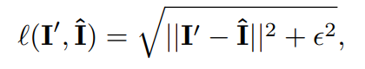
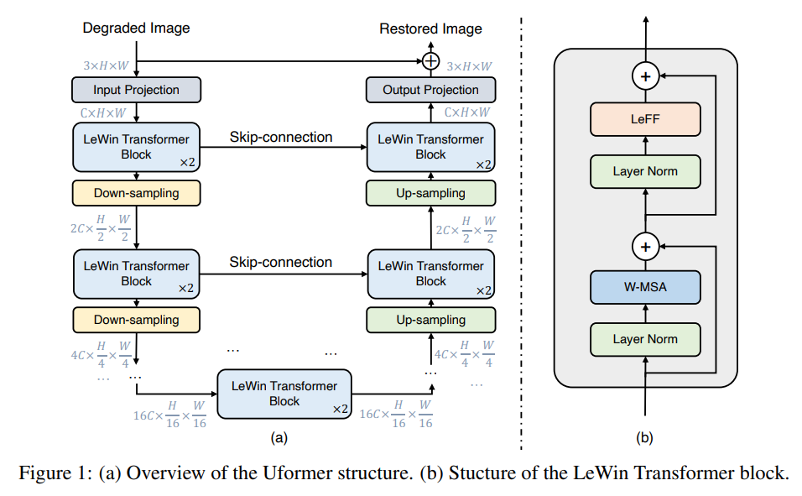
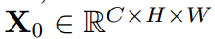
Method
Charbonnier loss
首先应用 3×3 卷积层和 LeakyReLU 来提取低级特征
先将feature拉成2D的，然后再用 4 × 4卷积步长为2的将降采样，同时通道数加倍
用 4 × 4卷积步长为2的反卷积进行上采样
先将feature拉成2D的，然后再用 3*3的卷积获得残差图

Slide 29
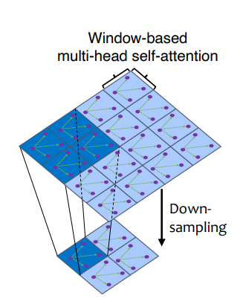
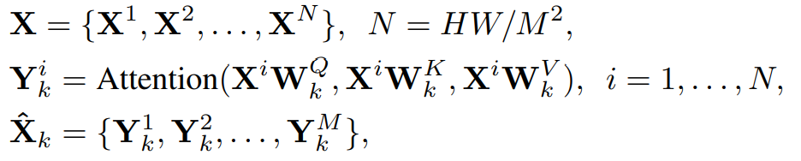
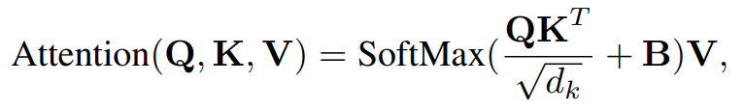
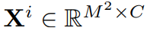
Window-based Multi-head Self-Attention (W-MSA)
Perform the self-attention within non-overlapping local windows, which reduces the computational cost significantly.
Thanks to the hierarchical structure, the Transformer blocks capture longer dependencies.
split X into non-overlapping windows with the window size of M × M, and then get the flattened and transposed features
from each window i.
The non-overlapping windows of two neighboring stages where the receptive fields at the low resolution are larger.

Slide 30
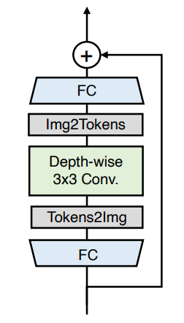
Locally-enhanced Feed-Forward Network (LeFF)
the Feed-Forward Network (FFN) in the standard Transformer presents limited capability to leverage local context
neighboring pixels are crucial references for image restoration
we first apply a linear projection layer to each token to increase its feature dimension.
we reshape the tokens to 2D feature maps, and use a 3 × 3 depth-wise convolution to capture local information.
Then we flatten the features to tokens and shrink the channels via another linear layer to match the dimension of the input channels. We use GELU as the activation function after each linear/convolution layer

Slide 31
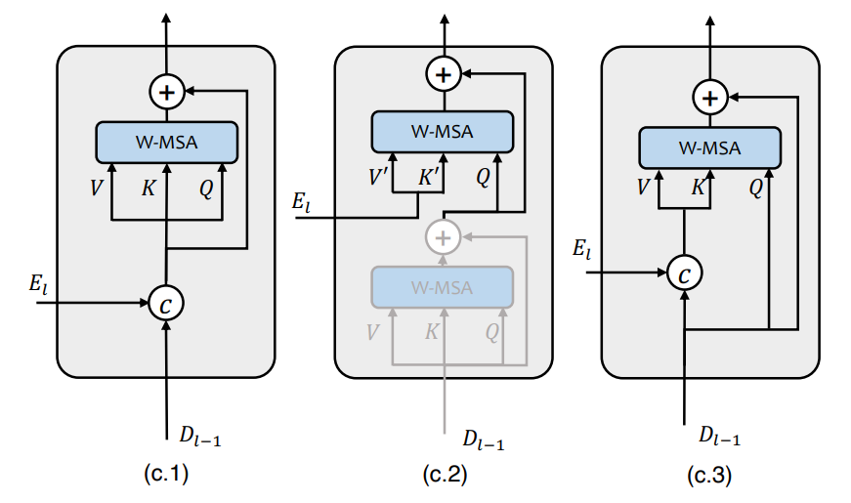
Variants of Skip-Connection
Concatenation-based Skip-connection:
Based on the widely-used skip-connection in UNet
Cross-attention as Skip-connection (Cross-Skip):
The first self-attention module in this block (the shaded one) is used to seek the self-similarity pixel-wisely from the decoder features
Concatenation-based Cross-attention as Skip-connection (ConcatCross-Skip):
concatenate the features El from the encoder and Dl−1 from the decoder as the keys and values, while the queries are only from the decoder.
(c.2). Concat-Skip
(c.2) Cross-Skip and (c.3) ConcatCross-Skip

Slide 32
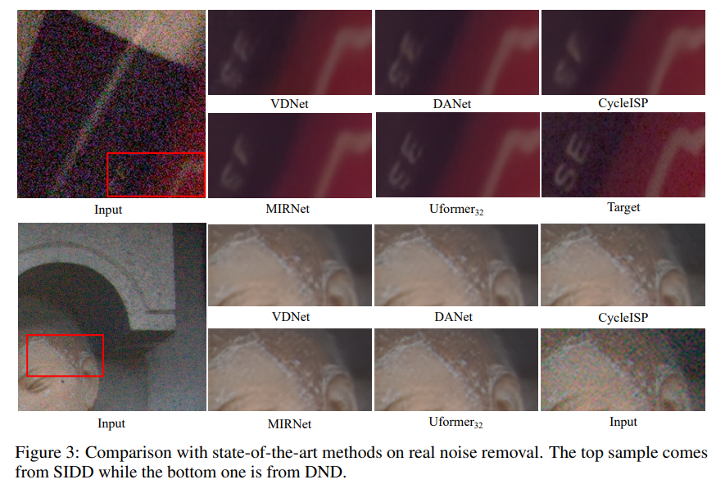
Experiment
Randomly augment the training samples using the horizontal flipping and rotate the images by 90◦ , 180◦ , or 270◦
set the window size to 8×8 in all LeWin Transformer blocks
Uformer for 250 epochs with batch size 32 and input image size 128 × 128 on 2 NVIDIA V100 GPUs

Slide 33
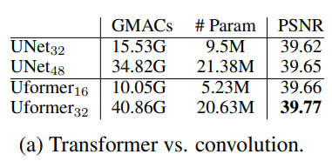
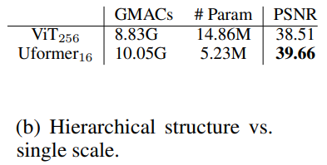
Experiment
Transformer vs. convolution.
replace all the LeWin Transformer blocks in Uformer with the convolution-based ResBlocks, resulting in the so-called "UNet", while keeping all others unchanged. feature concatenation (Concat-Skip) as the default skip-connection method.
Hierarchical structure vs. single scale
build a ViT-based architecture which only contains a single scale of the feature maps for image denoising. This architecture employs a head of two convolution layers for extracting features from the input image and also a tail of two convolution layers for the output. 12 standard Transformer blocks are used between the head and the tail. We train the ViT with the hidden dimension of 256 on patch size 16 × 16. The results are presented in Table 1(b)

Slide 34
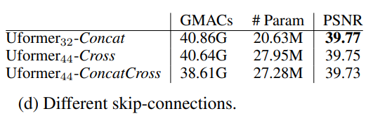
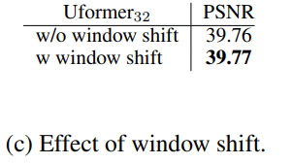
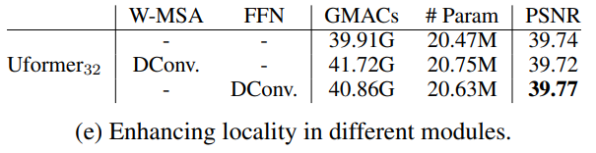
Experiment
Which skip-connection is better?
Is shifted window important?
The results of whether to use the shifted window(Swin Transformer) design in Uformer
Where to enhance locality?
Compares the results of no locality enhancement and enhancing locality in the self-attention calculation [9] or the feed-forward network

Slide 35
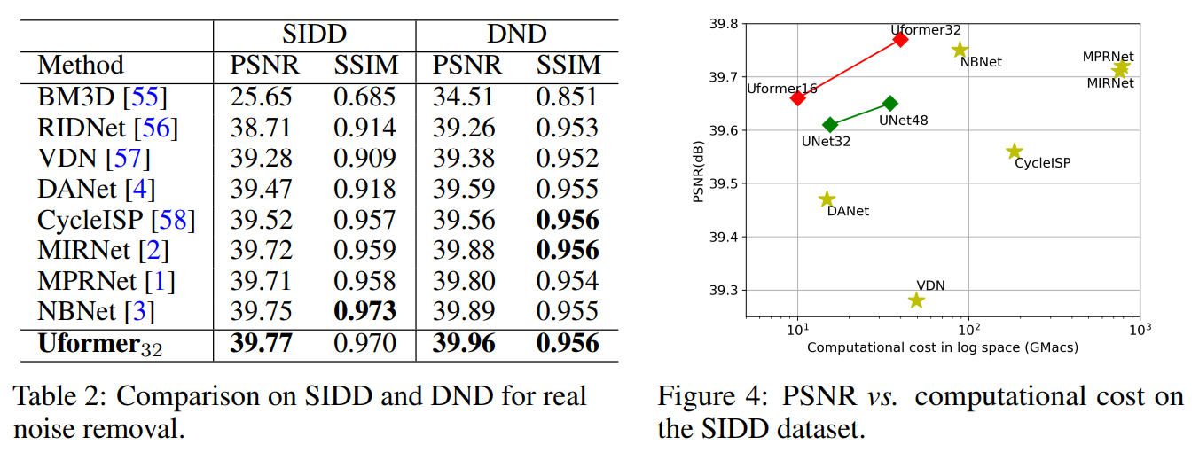
Experiment

Slide 36
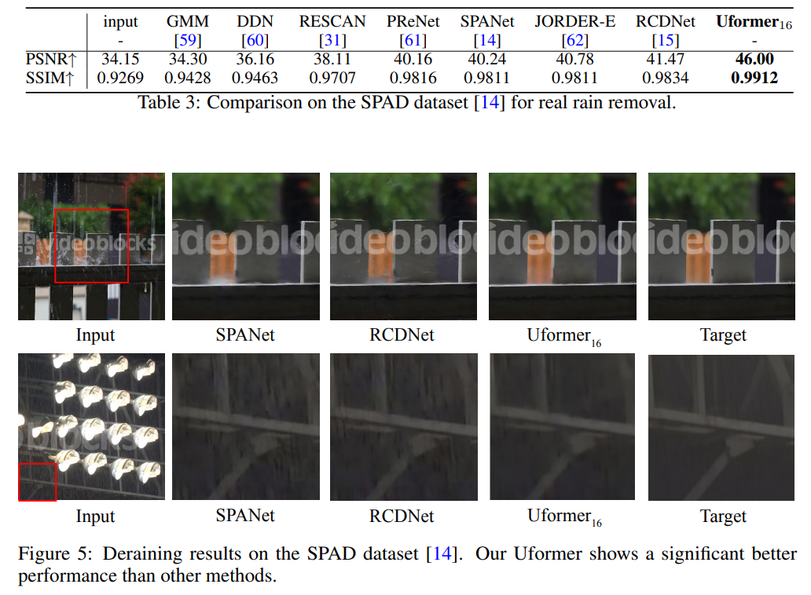
Experiment
remove the rain successfully while introducing fewer artifacts
SPANet CVPR2019
RCDNet CVPR2020

Slide 37

Experiment

Slide 38

Experiment

Slide 39

Experiment

Slide 40

Thank You!

